Slide 1

kiit (deemed to be university)
Subhendu kundu
1705085

Slide 2

WHAT IS ANDROID?
Android is a mobile operating system based on a modified version of the Linux kernel and other open source software, designed primarily for touchscreen mobile devices such as smartphones and tablets.

Slide 3
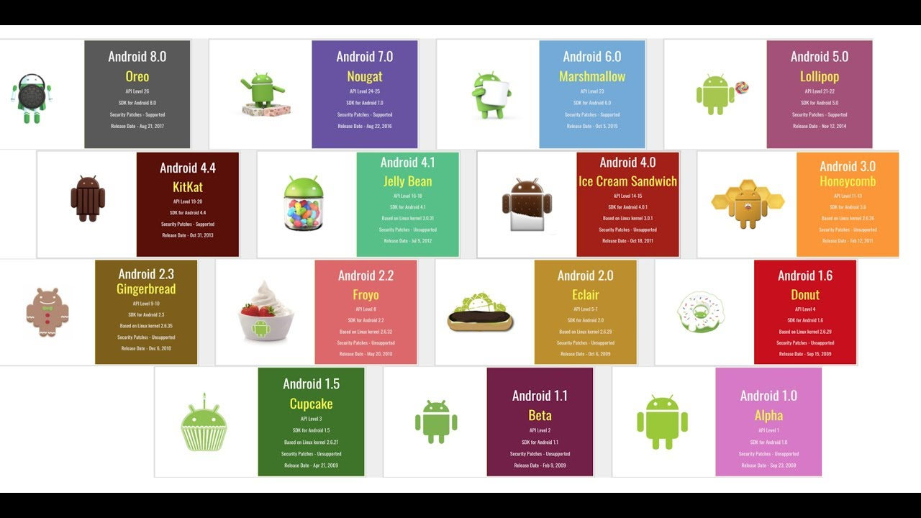
ANDROID Versions

Slide 4
ABSTRACT
An emergency is a situation that poses an immediate risk to health, life, property, or environment. Most emergencies require urgent intervention to prevent a worsening of the situation, although in some situations, mitigation may not be possible and agencies may only be able to offer palliative care for the aftermath.
While some emergencies are self-evident (such as a natural disaster that threatens many lives), many smaller incidents require that an observer (or affected party) decide whether it qualifies as an emergency. The precise definition of an emergency, the agencies involved and the procedures used, vary by jurisdiction, and this is usually set by the government, whose agencies (emergency services) are responsible for emergency planning and management.
An ambulance is a medically equipped vehicle which transports patients to treatment facilities, such as hospitals. In some instances, out-of-hospital medical care is provided to the patient.
Ambulances are used to respond to medical emergencies by emergency medical services. For this purpose, they are generally equipped with flashing warning lights and sirens. They can rapidly transport paramedics and other first responders to the scene, carry equipment for administering emergency care and transport patients to hospital or other definitive care. Most ambulances use a design based on vans or pick-up trucks. Others take the form of motorcycles, cars, buses, aircraft and boats.

Slide 5
INTRODUCTION
The primary focus of an Ambulance Service Team is two-fold: The first is to reach people in emergency situations as quickly as possible and administer life-saving first-aid on the spot. The second is to transport the sick or injured patient as quickly as possible to the appropriate healthcare facility for further care.
Emergency medical services (EMS), also known as ambulance services or paramedic services, are emergency services which treat illnesses and injuries that require an urgent medical response, providing out-of-hospital treatment and transport to definitive care. They may also be known as a first aid squad, FAST squad, emergency squad, rescue squad, ambulance squad, ambulance corps, life squad or by other initialisms such as EMAS or EMARS.

Slide 6
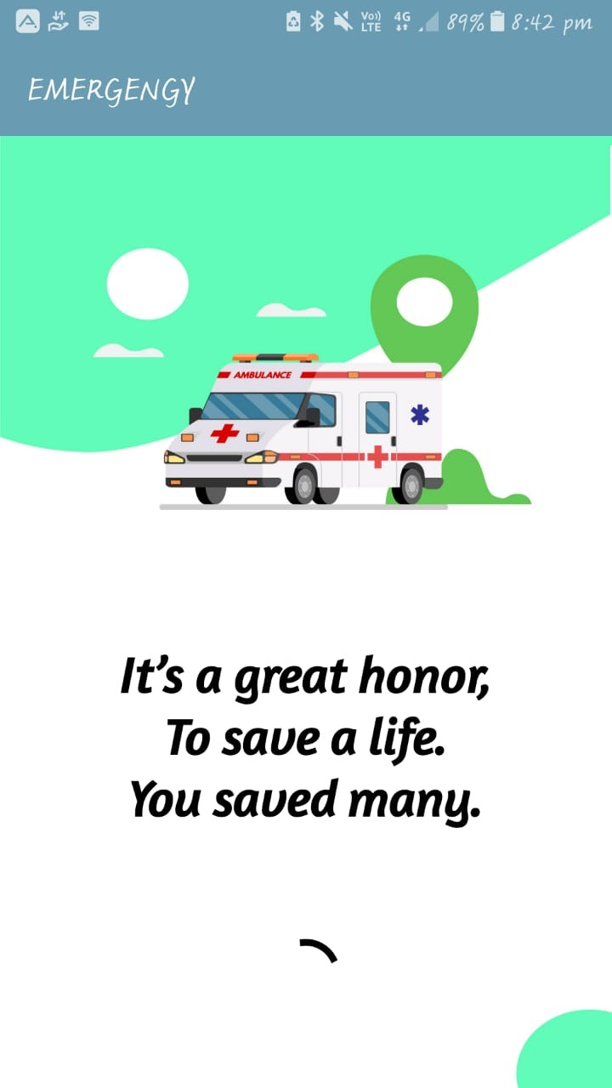
INTRODUCTARY SCREEN
This is the first splash screen where the app takes 3 second of time to load.

Slide 7
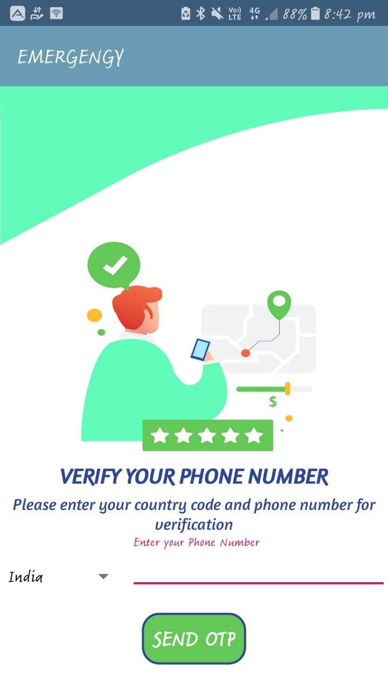
SCREEN MOBILE VERIFICATION
This activityis created for the phone number verification of the user using OTP and also it is use for forget password feature .

Slide 8
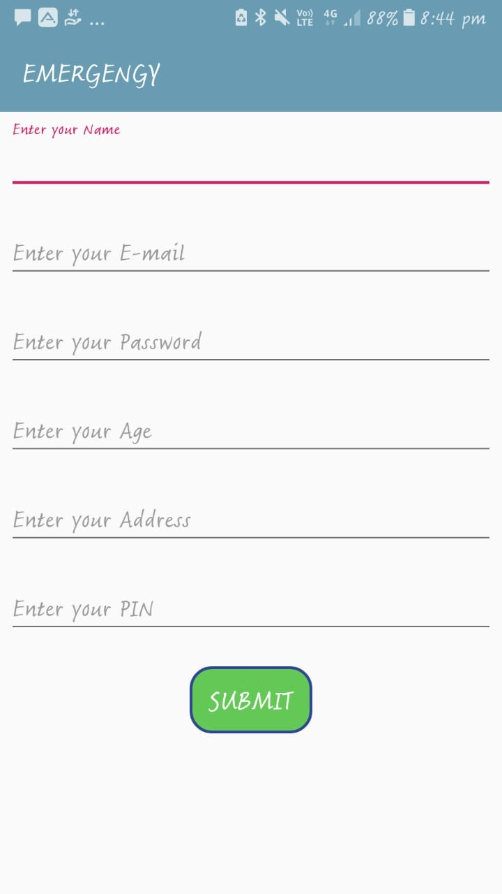
REGISTER SCREEN
This is the register activity where the user register himself with by submitting his name ,email, password, age, address, and pin.

Slide 9
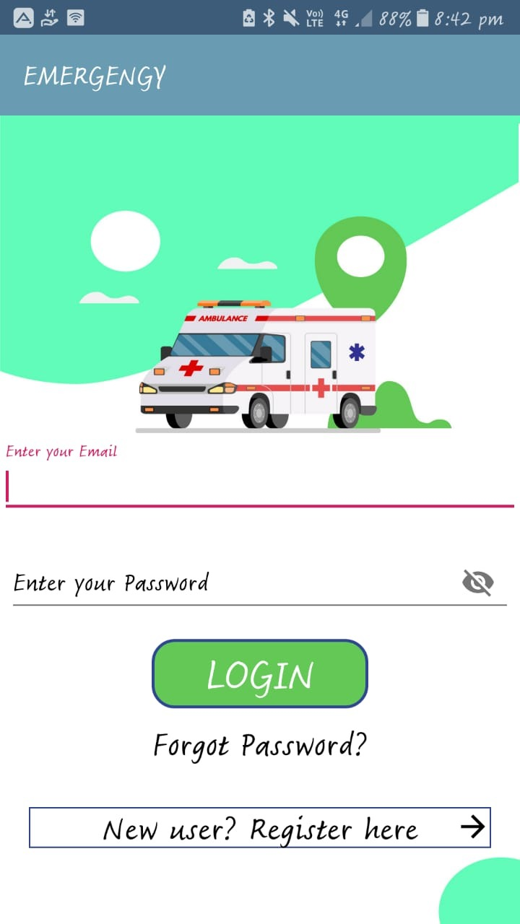
LOGIN SCREEN
In this activity the user log in the emergency app with help of email id and password.
In this activity also has the feature of forgot password by the virtue of which user can reset his password if he/ she forget.

Slide 10
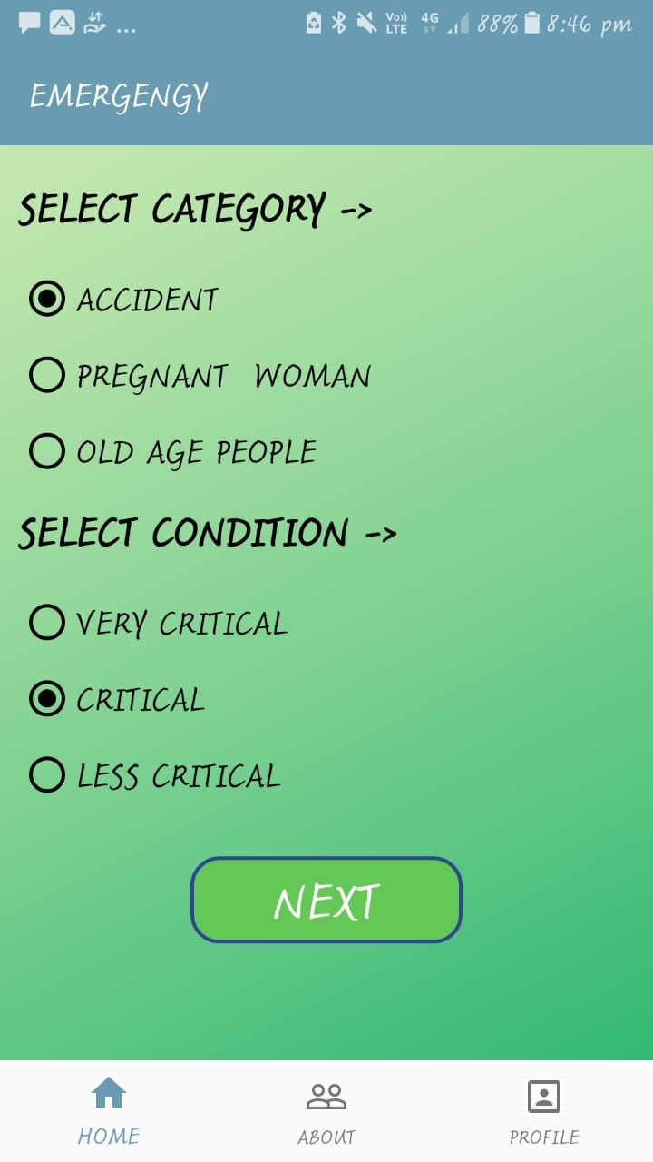
CATEGORY AND CONDITION SCREEN
In this activity the user must select a category and a condition of that situation when the user books the ambulance. For now we have 3 categories, i.e. this ambulance app will take care of accident victims, pregnant women, old age (senior citizens) people.
For the condition we have very 3 options critical, critical and less critical.
This will just help ambulance service to work more proficiently.

Slide 11
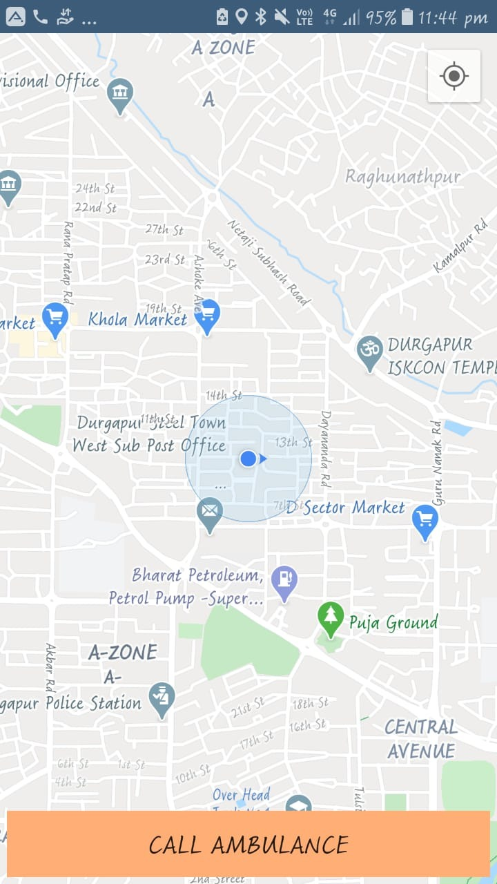
CALL AMBULANCE
As soon as the user selects appropriate options he/she will be directed to this activity where user can call ambulance by clicking on the call ambulance button.
Also this map shows the users current location.

Slide 12
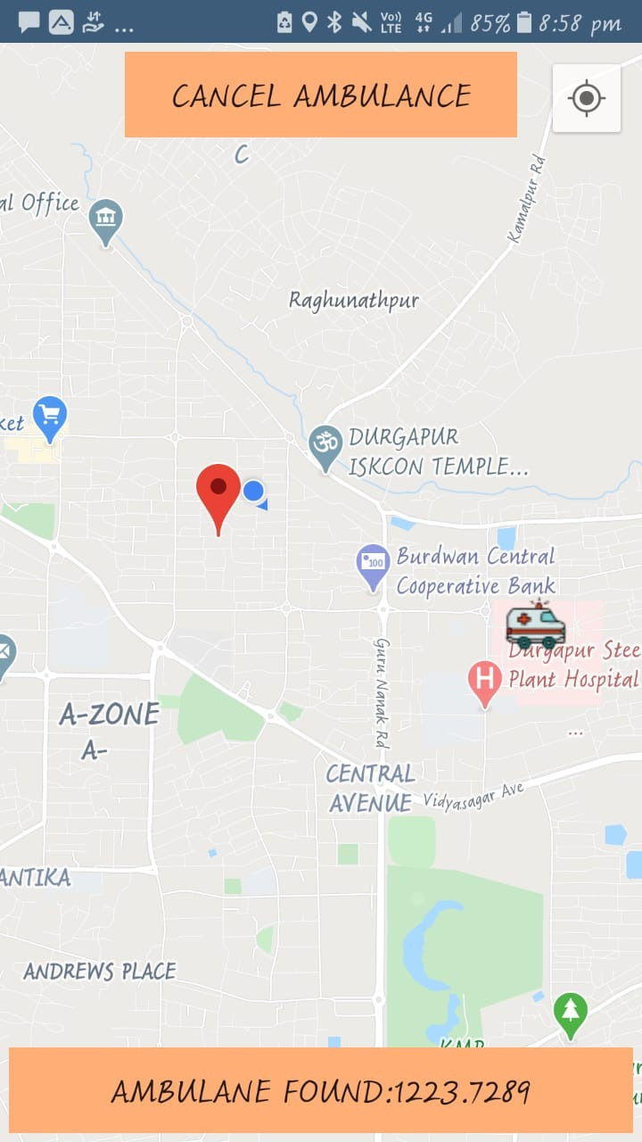
AMBULANCE FOUND
As soon as the user call the ambulance, our app will automatically find the nearest ambulance
And the this will appear where user can see the ambulance location and also user can see the distance between ambulance and his/her location.

Slide 13
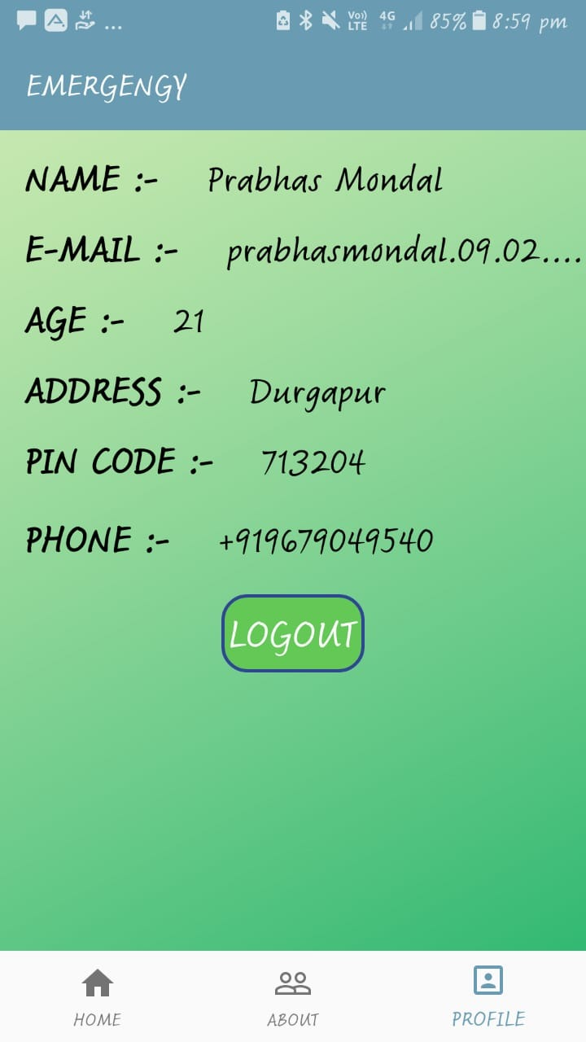
PROFILE ACTIVITY
In this activity, the user can view his own details which he/she has submitted during registration.

Slide 14
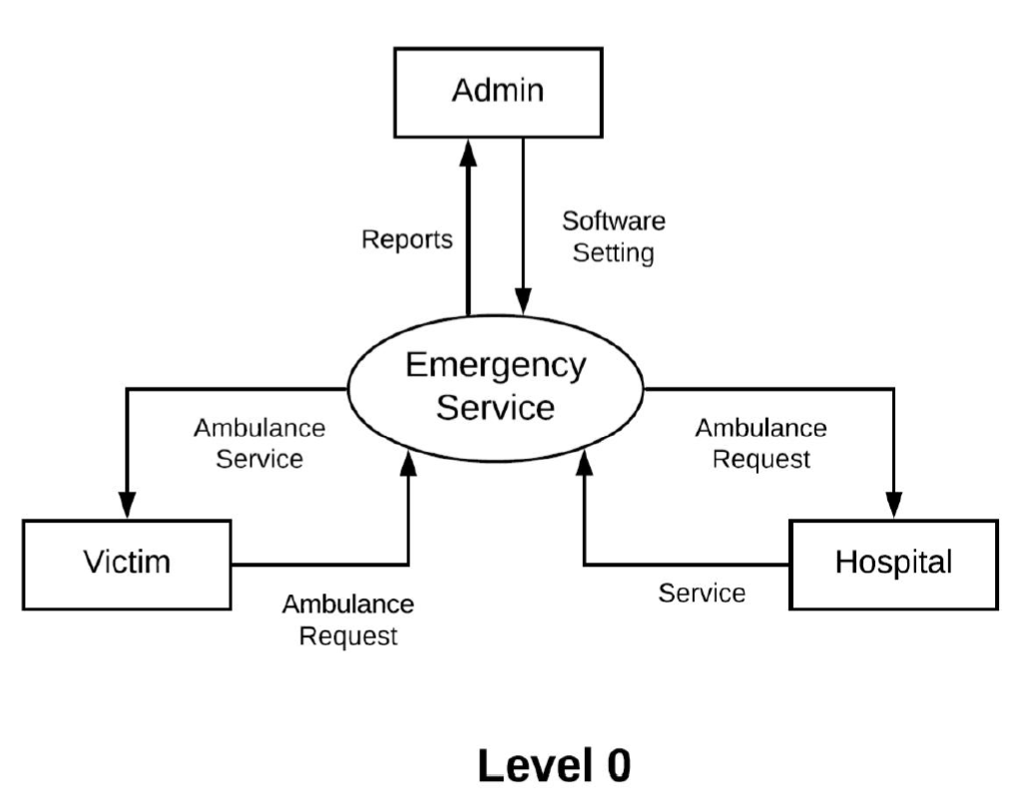
DATA FLOW DIAGRAM

Slide 15
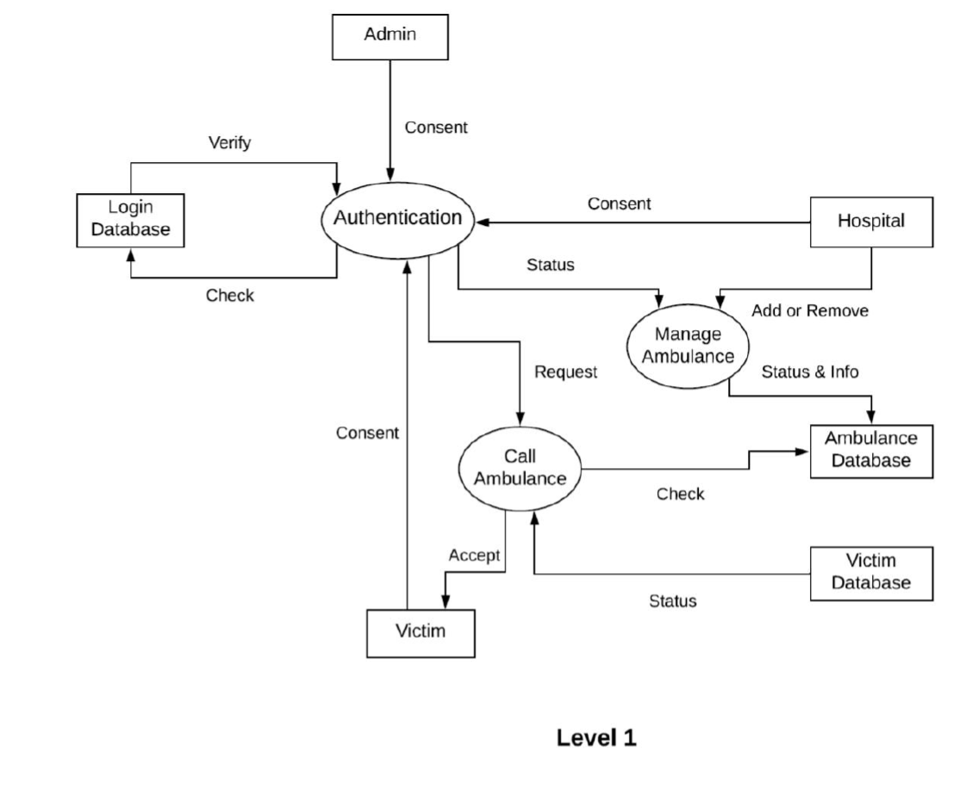
DATA FLOW DIAGRAM

Slide 16
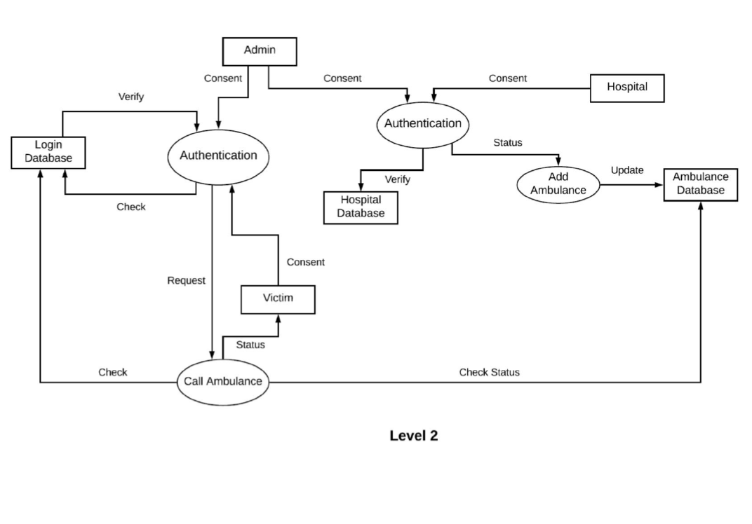
DATA FLOW DIAGRAM

Slide 17
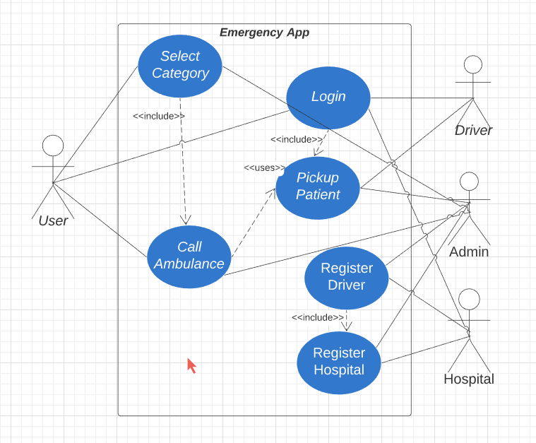
USE CASE DIAGRAM

Slide 18
THANK YOU

